Slide 1
Extra parts of M- and Z-Estimators
Jaehyoung Hong

Slide 2
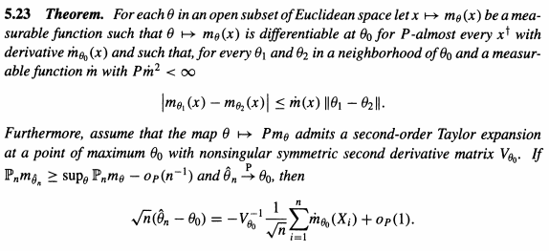
“Classical Conditions” for asymptotic normality of M-estimators require stronger assumption but lead to simple proof
Classical condition: 1930~1940 (Fisher,…)
Recall Theorem 5.23
Asymptotic normality requires only the existence of 2nd–order Taylor expansion

Slide 3



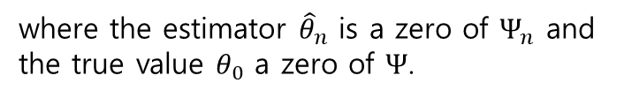

“Classical Conditions” for asymptotic normality of M-estimators require stronger assumption but lead to simple proof
Classical Condition
Let the observations $X_{1},X_{2},…,X_{n}$
$$Ψ_{n}\left(θ\right)=\frac{1}{n}\sum_{i=1}^{n}{ψ_{θ}(X_{i})}=P_{n}ψ_{θ}, Ψ\left(θ\right)=Pψ_{θ}$$
where the estimator ${\hat{θ}}_{n}$ is a zero of $Ψ_{n}$ and the true value $θ_{0}$ a zero of $Ψ$.
The essential condition of the following theorem is 2nd-order partial derivatives of $ψ_{θ}(x)$
$$\left|\frac{∂^{2}ψ_{θ,h}(x)}{∂θ_{i}θ_{j}}\right|≤\ddot{ψ}(x)$$
(1)
Classical condition requires third derivatives

Slide 4

Thm 5.41: Classical condition for asymptotic normality
Thm 5.41. For each $θ$ in an open subset of Euclidean space, let $θ→ψ_{θ}(x)$ be twice continuously differentiable for every $x$. Suppose that $Pψ_{θ_{0}}=0$, that $P{\left\|ψ_{θ_{0}}\right\|}^{2}<∞$ and that the matrix $P{\dot{ψ}}_{θ_{0}}$ exists and is nonsingular. Assume (1) for every $θ$ in a neighborhood of $θ_{0}$. Then every consistent estimator sequence ${\hat{θ}}_{n}$ such that $Ψ_{n}\left({\hat{θ}}_{n}\right)=0$ for every $n$ satisfies
$\sqrt{n}\left({\hat{θ}}_{n}−θ_{0}\right)=−{\left(P{\dot{ψ}}_{θ_{0}}\right)}^{−1}\frac{1}{\sqrt{n}}\sum_{i=1}^{n}{ψ_{θ_{0}}\left(X_{i}\right)}+o_{p}\left(1\right).$
In particular, the sequence $\sqrt{n}\left({\hat{θ}}_{n}−θ_{0}\right)$ is asymptotically normal with mean zero and covariance matrix ${\left(P{\dot{ψ}}_{θ_{0}}\right)}^{−1}Pψ_{θ_{0}}ψ_{θ_{0}}^{T}{\left(P{\dot{ψ}}_{θ_{0}}\right)}^{−1}$.

Slide 5
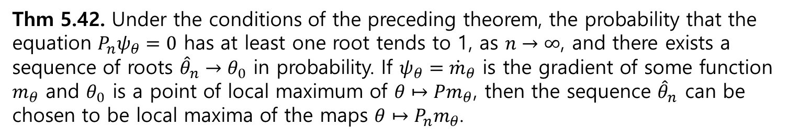

Thm 5.42: “Classical Conditions” ensure the existence of consistent solution ${\hat{θ}}_{n}$
Thm 5.42. Under the conditions of the preceding theorem, the probability that the equation $P_{n}ψ_{θ}=0$ has at least one root tends to 1, as $n→∞$, and there exists a sequence of roots ${\hat{θ}}_{n}→θ_{0}$ in probability. If $ψ_{θ}={\dot{m}}_{θ}$ is the gradient of some function $m_{θ}$ and $θ_{0}$ is a point of local maximum of $θ↦Pm_{θ}$, then the sequence ${\hat{θ}}_{n}$ can be chosen to be local maxima of the maps $θ↦P_{n}m_{θ}$.
Existence of consistent solution + how to select such solution
Not guarantee the existence of asymptotically consistent estimators
If $Pψ_{θ}$ has more than one solution the roots of $P_{n}ψ_{θ}$ are bad estimator

Slide 6



One-step method improves given preliminary estimator ${\tilde{θ}}_{n}$
Two problems of the method of Z-estimation
1. May be hard to find the roots of the estimating equation
2. For the roots to be consistent, the estimating equation needs to behave well throughout the parameter set
Idea of One-step estimator
$$Ψ_{n}\left({\tilde{θ}}_{n}\right)+{\dot{Ψ}}_{n}\left({\tilde{θ}}_{n}\right)\left(θ−{\tilde{θ}}_{n}\right)=0$$
$${\hat{θ}}_{n}={\tilde{θ}}_{n}−{\dot{Ψ}}_{n}{\left({\tilde{θ}}_{n}\right)}^{−1}Ψ_{n}({\tilde{θ}}_{n})$$
Newton-Rhapson method in numerical analysis
But we only consider one-step (${\tilde{θ}}_{n}$ is already within range $n^{−1/2}$ of the true value $θ)$
Then, we can provide consistency from inconsistent Z-estimator

Slide 7


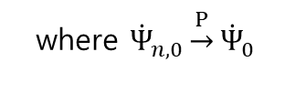

Thm 5.45: One-step estimation
Condition for $Ψ_{n}$
$$\sup_{\sqrt{n}\left\|θ−θ_{0}\right\|<M}\left\|\sqrt{n}\left(Ψ_{n}\left(θ\right)−Ψ_{n}\left(θ_{0}\right)\right)−{\dot{Ψ}}_{0}\sqrt{n}(θ−θ_{0})\right\|\underset{→}{P}0$$
One-step estimator
$${\hat{θ}}_{n}={\tilde{θ}}_{n}−{\dot{Ψ}}_{n,0}^{−1}Ψ_{n}({\tilde{θ}}_{n})$$
where ${\dot{Ψ}}_{n,0}\underset{→}{P}{\dot{Ψ}}_{0}$
$\sqrt{n}$-consistent
The sequence $\sqrt{n}\left({\tilde{θ}}_{n}−θ_{0}\right)$ is uniformly tight
One-step estimation
Thm 5.45. Let $\sqrt{n}Ψ_{n}\left(θ_{0}\right)⇝Z$ with condition for $Ψ_{n}$. Then the one-step estimator ${\hat{θ}}_{n}$, for a given $\sqrt{n}$-consistent estimator sequence ${\tilde{θ}}_{n}$ and estimators ${\dot{Ψ}}_{n,0}\underset{→}{P}{\dot{Ψ}}_{0}$ satisfies
$$\sqrt{n}\left({\hat{θ}}_{n}−θ_{0}\right)=−{\dot{Ψ}}_{0}^{−1}\sqrt{n}Ψ_{n}\left(θ_{0}\right)+o_{p}(1)$$

Slide 8
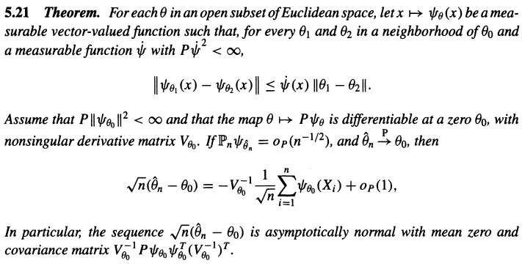
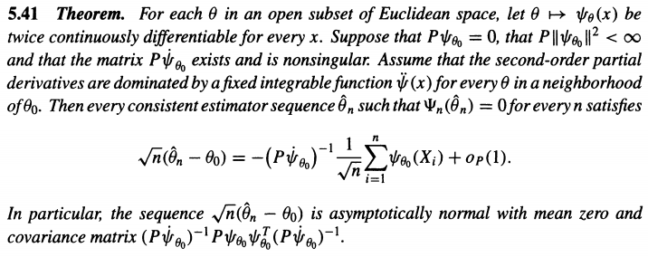
Thm 5.45: One-step estimation
Condition for $Ψ_{n}$
$$\sup_{\sqrt{n}\left\|θ−θ_{0}\right\|<M}\left\|\sqrt{n}\left(Ψ_{n}\left(θ\right)−Ψ_{n}\left(θ_{0}\right)\right)−{\dot{Ψ}}_{0}\sqrt{n}(θ−θ_{0})\right\|\underset{→}{P}0$$
Addendum
If the sequence $\sqrt{n}({\hat{θ}}_{n}−θ_{0})$ converge in distribution → Uniquely tight
→ Satisfies assumption of one-step estimation
→ “Two-step” estimation (But usually does not give asymptotic improvement: same limit distribution)

Slide 9


Thm 5.48: Discretized One-step estimation
Discretized Condition for $Ψ_{n}$
For every nonrandom sequence $θ_{n}=θ_{0}+O(n^{{−1}/2})$
$$\left\|\sqrt{n}\left(Ψ_{n}\left(θ_{n}\right)−Ψ_{n}\left(θ_{0}\right)\right)−{\dot{Ψ}}_{0}\sqrt{n}(θ−θ_{0})\right\|\underset{→}{P}0$$
One-step estimator
$${\hat{θ}}_{n}={\tilde{θ}}_{n}−{\dot{Ψ}}_{n,0}^{−1}Ψ_{n}({\tilde{θ}}_{n})$$
where ${\dot{Ψ}}_{n,0}\underset{→}{P}{\dot{Ψ}}_{0}$
$\sqrt{n}$-consistent
The sequence $\sqrt{n}\left({\tilde{θ}}_{n}−θ_{0}\right)$ is uniformly tight
Discretized One-step estimation
Thm 5.45. Let $\sqrt{n}Ψ_{n}\left(θ_{0}\right)⇝Z$ with condition for $Ψ_{n}$. Then the one-step estimator ${\hat{θ}}_{n}$, for a given discretized $\sqrt{n}$-consistent estimator sequence ${\tilde{θ}}_{n}$ and estimators ${\dot{Ψ}}_{n,0}\underset{→}{P}{\dot{Ψ}}_{0}$ satisfies
$$\sqrt{n}\left({\hat{θ}}_{n}−θ_{0}\right)=−{\dot{Ψ}}_{0}^{−1}\sqrt{n}Ψ_{n}\left(θ_{0}\right)+o_{p}(1)$$

Slide 10

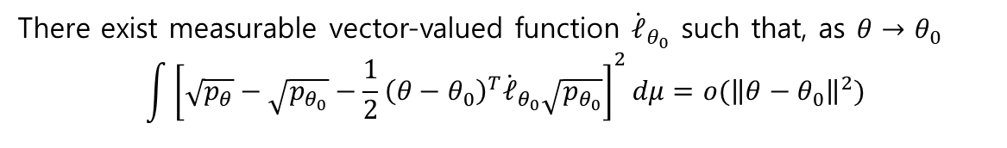
Thm 5.48: Discretized One-step estimation
Discretized Condition for $Ψ_{n}$
For every nonrandom sequence $θ_{n}=θ_{0}+O(n^{{−1}/2})$
$$\left\|\sqrt{n}\left(Ψ_{n}\left(θ_{n}\right)−Ψ_{n}\left(θ_{0}\right)\right)−{\dot{Ψ}}_{0}\sqrt{n}(θ−θ_{0})\right\|\underset{→}{P}0$$
Differentiable in quadratic mean
There exist measurable vector-valued function ${\dot{ℓ}}_{θ_{0}}$ such that, as $θ→θ_{0}$
$$\int{{\left[\sqrt{p_{θ}}−\sqrt{p_{θ_{0}}}−\frac{1}{2}{\left(θ−θ_{0}\right)}^{T}{\dot{ℓ}}_{θ_{0}}\sqrt{p_{θ_{0}}}\right]}^{2}dμ=o({\left\|θ−θ_{0}\right\|}^{2})}$$
Addendum
For $Ψ_{n}\left(θ_{0}\right)=P_{n}ψ_{θ}$ and $P_{n}$ is the empirical measure of a random sample from a density $p_{θ}$ that is differentiable in quadratic mean, then condition for $Ψ_{n}$ is satisfied with ${\dot{Ψ}}_{0}=−P_{θ_{0}}ψ_{θ_{0}}{\dot{ℓ}}_{θ_{0}}^{T}$, if, as $θ→θ_{0}$
$$\int{{\left[ψ_{θ}\sqrt{p_{θ}}−ψ_{θ_{0}}\sqrt{p_{θ_{0}}}\right]}^{2}dμ→0}$$
Addendum requires only continuity of $θ↦ψ_{θ}$ (Condition for $Ψ_{n}$ requires differentiability)

Slide 11


Example: Cauchy distribution
$X_{1},X_{2},…,X_{n}\sim p_{θ}$
$$p_{θ}\left(x\right)=π^{−1}{\left(1+{\left(x−θ\right)}^{2}\right)}^{−1}$$
$${\dot{ℓ}}_{θ}\left(x\right)=\frac{2(x−θ)}{1+{\left(x−θ\right)}^{2}}$$
$${\overset{⃛}{ℓ}}_{θ}\left(x\right)=\frac{4(x−θ)({\left(x−θ\right)}^{2}−3)}{{\left(1+{\left(x−θ\right)}^{2}\right)}^{3}}$$
The tails of ${\overset{⃛}{ℓ}}_{θ}\left(x\right)$ are of the order $1/{x^{3}}$, and the function is bounded in between.
These bounds are uniform in $θ$ varying over a compact interval.
Assumption of Thm. 5.41, 5.42 is satisfied & Consistency followed from Example 5.16
→ MLE estimator is Asymptotically normal

Slide 12
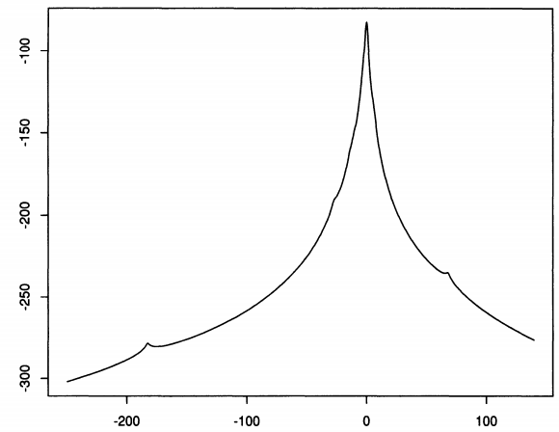

Example: Cauchy distribution
But usually $\sum{{\dot{ℓ}}_{θ}\left(X_{i}\right)=0}$ has multiple root → Bad estimator
One-step estimation is often recommend

Slide 13
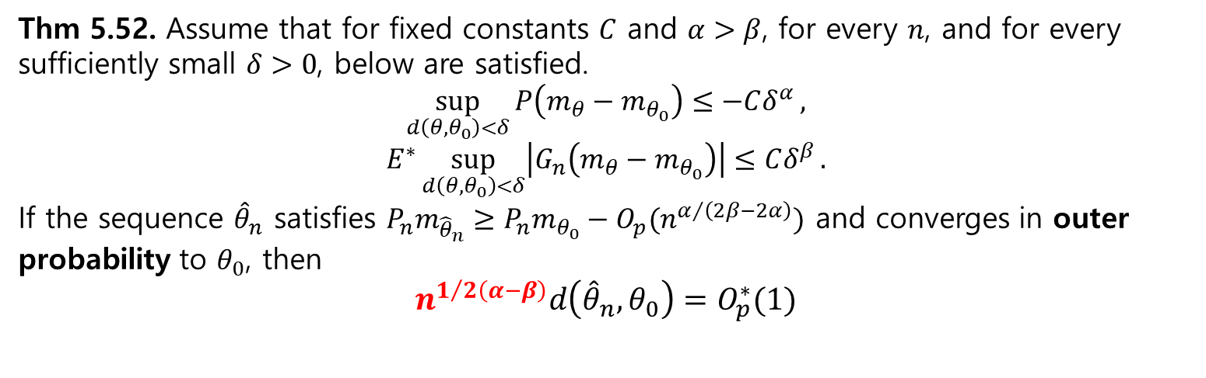
Thm 5.52: Rate of convergence by separating the deterministic map and the random fluctuation
${\hat{θ}}_{n}$: (nearly) maximize the criterion function $θ↦{P_{n}m}_{θ}(x)$ where $x↦m_{θ}(x)$ is a measurable function
$θ↦{P_{n}m}_{θ}=θ↦{Pm}_{θ}+θ↦P_{n}m_{θ}−{Pm}_{θ}$
Deterministic map
Random fluctuation
$G_{n}m_{θ}=\sqrt{n}(P_{n}m_{θ}−Pm_{θ})$
Thm 5.52. Assume that for fixed constants $C$ and $α>β$, for every $n$, and for every sufficiently small $δ>0$, below are satisfied.
$$\sup_{d\left(θ,θ_{0}\right)<δ}{P\left(m_{θ}−m_{θ_{0}}\right)≤−Cδ^{α}},$$
$$E^{∗}\sup_{d\left(θ,θ_{0}\right)<δ}\left|G_{n}\left(m_{θ}−m_{θ_{0}}\right)\right|≤Cδ^{β}.$$
If the sequence ${\hat{θ}}_{n}$ satisfies $P_{n}m_{{\hat{θ}}_{n}}≥P_{n}m_{θ_{0}}−O_{p}(n^{α/{\left(2β−2α\right)}})$ and converges in outer probability to $θ_{0}$, then
$$n^{1/{2\left(α−β\right)}}d\left({\hat{θ}}_{n},θ_{0}\right)=O_{p}^{∗}(1)$$

Slide 14
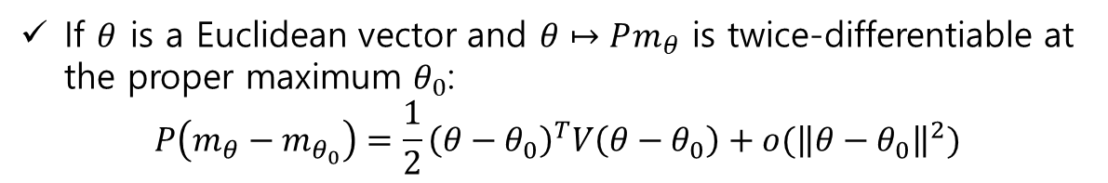
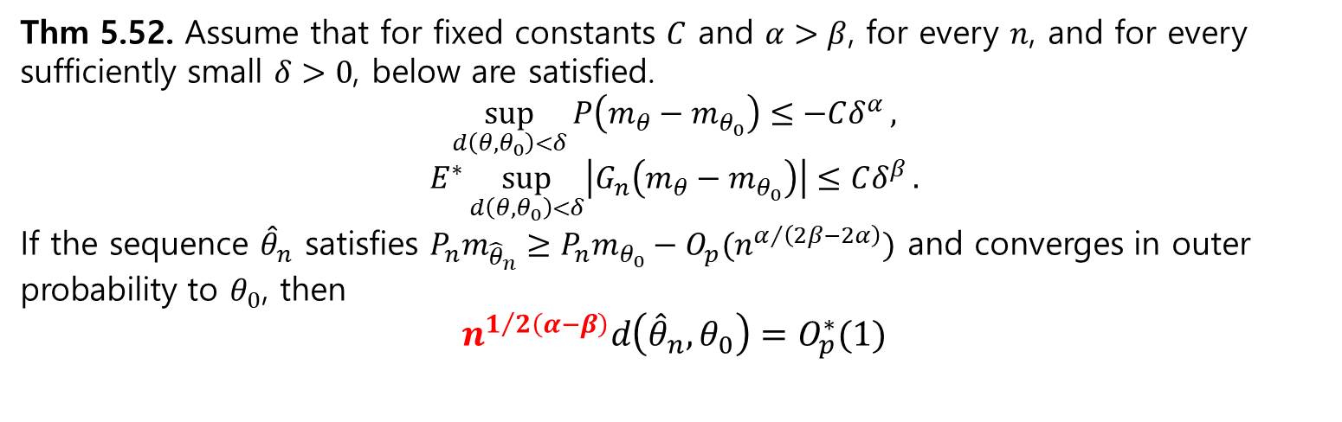


Thm 5.52: Rate of convergence by separating the deterministic map and the random fluctuation
Thm 5.52. Assume that for fixed constants $C$ and $α>β$, for every $n$, and for every sufficiently small $δ>0$, below are satisfied.
$$\sup_{d\left(θ,θ_{0}\right)<δ}{P\left(m_{θ}−m_{θ_{0}}\right)≤−Cδ^{α}},$$
$$E^{∗}\sup_{d\left(θ,θ_{0}\right)<δ}\left|G_{n}\left(m_{θ}−m_{θ_{0}}\right)\right|≤Cδ^{β}.$$
If the sequence ${\hat{θ}}_{n}$ satisfies $P_{n}m_{{\hat{θ}}_{n}}≥P_{n}m_{θ_{0}}−O_{p}(n^{α/{\left(2β−2α\right)}})$ and converges in outer probability to $θ_{0}$, then
$$n^{1/{2\left(α−β\right)}}d\left({\hat{θ}}_{n},θ_{0}\right)=O_{p}^{∗}(1)$$
If $θ$ is a Euclidean vector and $θ↦Pm_{θ}$ is twice-differentiable at the proper maximum $θ_{0}$:
$$P\left(m_{θ}−m_{θ_{0}}\right)=\frac{1}{2}{\left(θ−θ_{0}\right)}^{T}V\left(θ−θ_{0}\right)+o({\left\|θ−θ_{0}\right\|}^{2})$$
$$α=2$$
Second condition called “maximal inequality” usually holds with $β=1$ for ‘regular’ case (See Ch.19 for more general cases)

Slide 15
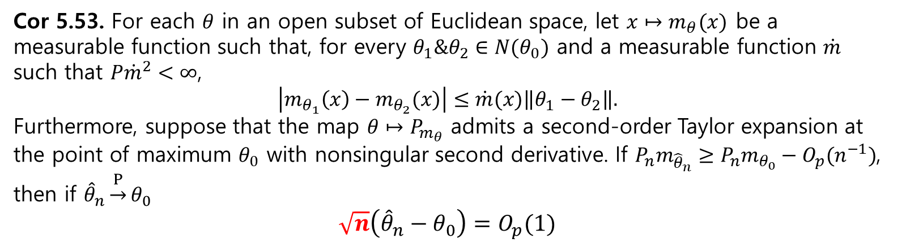
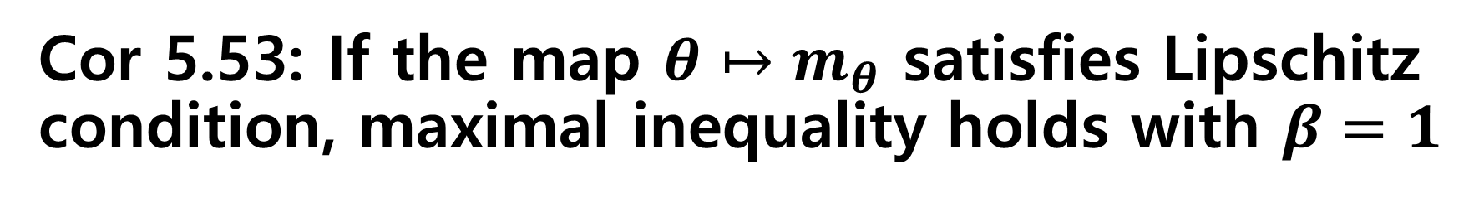
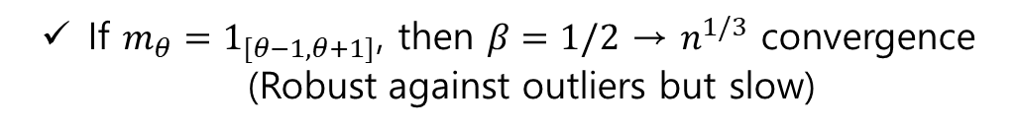
Cor 5.53: If the map $θ↦m_{θ}$ satisfies Lipschitz condition, maximal inequality holds with $β=1$
Cor 5.53. For each $θ$ in an open subset of Euclidean space, let $x↦m_{θ}(x)$ be a measurable function such that, for every $θ_{1}\&θ_{2}∈N(θ_{0})$ and a measurable function $\dot{m}$ such that $P{\dot{m}}^{2}<∞$,
$$\left|m_{θ_{1}}\left(x\right)−m_{θ_{2}}(x)\right|≤\dot{m}(x)\left\|θ_{1}−θ_{2}\right\|.$$
Furthermore, suppose that the map $θ↦P_{m_{θ}}$ admits a second-order Taylor expansion at the point of maximum $θ_{0}$ with nonsingular second derivative. If $P_{n}m_{{\hat{θ}}_{n}}≥P_{n}m_{θ_{0}}−O_{p}(n^{−1})$, then if ${\hat{θ}}_{n}\underset{→}{P}θ_{0}$
$$\sqrt{n}\left({\hat{θ}}_{n}−θ_{0}\right)=O_{p}(1)$$
Condition 1 is holds with $α=2$
Condition 2 is holds with $β=1$ (Cor. 19.35)
If $m_{θ}=1_{[θ−1,θ+1]}$, then $β=1/2$ → $n^{1/3}$ convergence (Robust against outliers but slow)

Slide 16
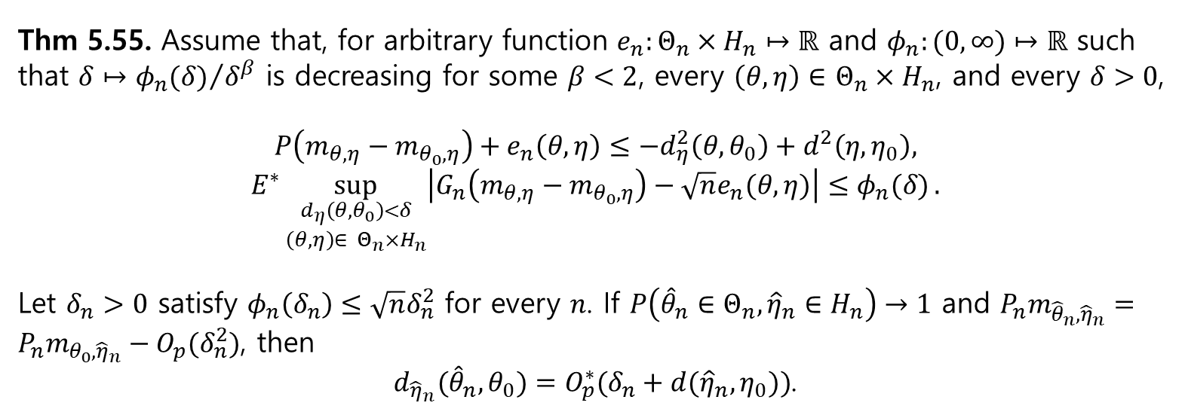

Thm 5.55: Delete consistency of ${\hat{θ}}_{n}$ by satisfying other condition for every $δ>0$ (Not sufficiently small $δ$)
Let $x↦m_{θ,η}(x)$ be measurable function, ${\hat{θ}}_{n}$ maximizes the map $θ↦P_{n}m_{θ,{\hat{η}}_{n}}$ for a given ${\hat{η}}_{n}$
Thm 5.55. Assume that, for arbitrary function $e_{n}:Θ_{n}×H_{n}↦ℝ$ and $φ_{n}:(0,∞)↦ℝ$ such that $δ↦{φ_{n}(δ)}/{δ^{β}}$ is decreasing for some $β<2$, every $\left(θ,η\right)∈$ $Θ_{n}×H_{n}$, and every $δ>0$,
$$P\left(m_{θ,η}−m_{θ_{0},η}\right)+e_{n}\left(θ,η\right)≤−d_{η}^{2}\left(θ,θ_{0}\right)+d^{2}\left(η,η_{0}\right),$$
$$E^{∗}\sup_{\begin{aligned}d_{η}\left(θ,θ_{0}\right)<δ \\ \left(θ,η\right)∈ Θ_{n}×H_{n}\end{aligned}}\left|G_{n}\left(m_{θ,η}−m_{θ_{0},η}\right)−\sqrt{n}e_{n}(θ,η)\right|≤φ_{n}(δ).$$
Let $δ_{n}>0$ satisfy $φ_{n}\left(δ_{n}\right)≤\sqrt{n}δ_{n}^{2}$ for every $n$. If $P\left({\hat{θ}}_{n}∈Θ_{n},{\hat{η}}_{n}∈H_{n}\right)→1$ and $P_{n}m_{{\hat{θ}}_{n},{\hat{η}}_{n}}=P_{n}m_{θ_{0},{\hat{η}}_{n}}−O_{p}(δ_{n}^{2})$, then
$d_{{\hat{η}}_{n}}({\hat{θ}}_{n},θ_{0})=O_{p}^{∗}(δ_{n}+d({\hat{η}}_{n},η_{0}))$.

